Slide 1



Retail Analysis Sample
View in Power BI
Last data refresh:
1/3/2025 2:28:55 AM UTC
Downloaded at:
1/3/2025 2:42:30 AM UTC

Slide 2
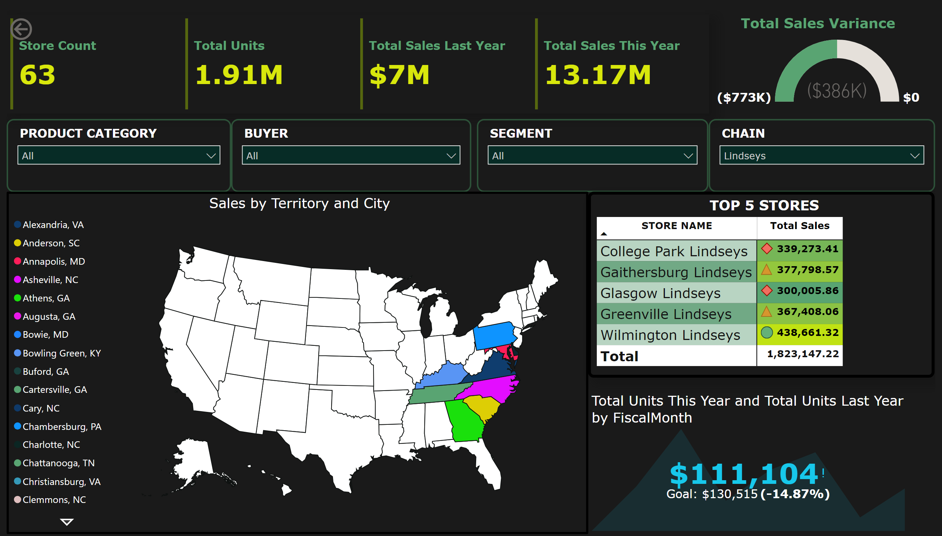
Power BI dashboard
Notes:
cardVisual
No alt text provided
slicer
No alt text provided
slicer
No alt text provided
slicer
No alt text provided
slicer
No alt text provided
TOP 5 STORES
No alt text provided
actionButton
No alt text provided
Sales by Territory and City
No alt text provided
kpi
No alt text provided
gauge
No alt text provided

